Slide 1
Some tricks for polynominal equasions

Slide 2

Split on factors
$x^{3}+x^{2}−x+2=0$
$x^{3}+1+ x^{2}−x+1=0$
$(x+1)(x^{2}−x+1) + (x^{2}−x+1)=0$
$(x+2)(x^{2}−x+1)=0$

Slide 3
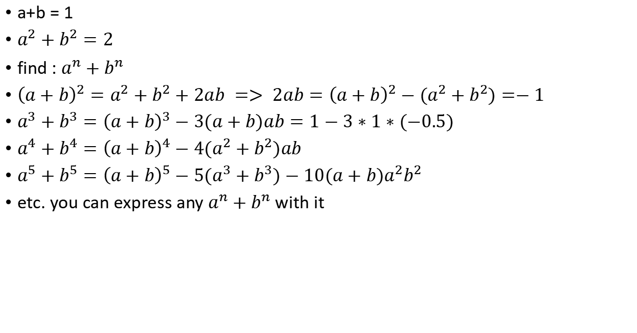
$${Express a}^{n}+b^{n}$$
a+b = 1
$a^{2}+b^{2}=2$
find : $a^{n}+b^{n}$
${\left(a+b\right)}^{2}=a^{2}+b^{2}+2ab => 2ab={\left(a+b\right)}^{2}−(a^{2}+b^{2})=−1$
$a^{3}+b^{3}={\left(a+b\right)}^{3}−3(a+b)ab=1−3∗1∗(−0.5)$
$a^{4}+b^{4}={\left(a+b\right)}^{4}−4(a^{2}+b^{2})ab$
$a^{5}+b^{5}={\left(a+b\right)}^{5}−5(a^{3}+b^{3})−10(a+b)a^{2}b^{2}$
etc. you can express any $a^{n}+b^{n}$ with it

Slide 4

$x+\frac{1}{x}$ tricks
$x+\frac{1}{x}=6$
find : $x^{n}+\frac{1}{x^{n}}$
${\left(x+\frac{1}{x}\right)}^{2}=x^{2}+\frac{1}{x^{2}}+2$
$x^{2}+\frac{1}{x^{2}}$ = $6^{2}−2$
${\left(x+\frac{1}{x}\right)}^{3}=x^{3}+\frac{1}{x^{3}}+3(x+\frac{1}{x})$
$x^{3}+\frac{1}{x^{3}}=6^{3}−3∗6$
etc for other grades

Slide 5
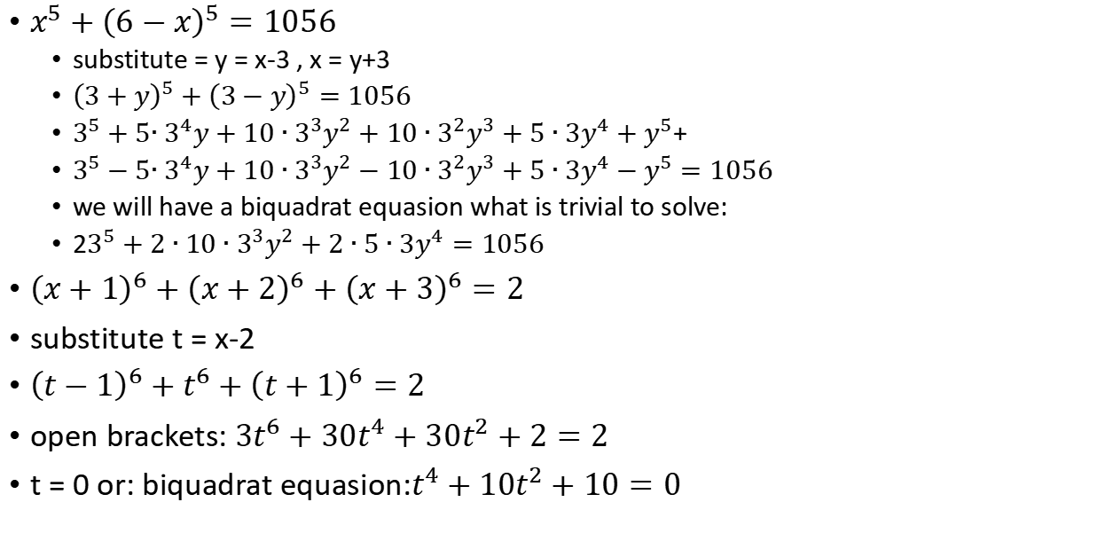
Equal splitting:
$x^{5}+{\left(6−x\right)}^{5}=1056$
substitute = y = x-3 , x = y+3
${\left(3+y\right)}^{5}+{\left(3−y\right)}^{5}=1056$
$3^{5}+5{∙3}^{4}y+10∙3^{3}y^{2}+10∙3^{2}y^{3}+5∙3y^{4}+y^{5}$+
$3^{5}−5{∙3}^{4}y+10∙3^{3}y^{2}−10∙3^{2}y^{3}+5∙3y^{4}−y^{5}=1056$
we will have a biquadrat equasion what is trivial to solve:
2$3^{5}+2∙10∙3^{3}y^{2}+2∙5∙3y^{4}=1056$
${\left(x+1\right)}^{6}+{\left(x+2\right)}^{6}+{\left(x+3\right)}^{6}=2$
substitute t = x-2
${\left(t−1\right)}^{6}+t^{6}+{\left(t+1\right)}^{6}=2$
open brackets: ${3t}^{6}+{30t}^{4}+{30t}^{2}+2=2$
t = 0 or: biquadrat equasion:$t^{4}+{10t}^{2}+10=0$

Slide 6
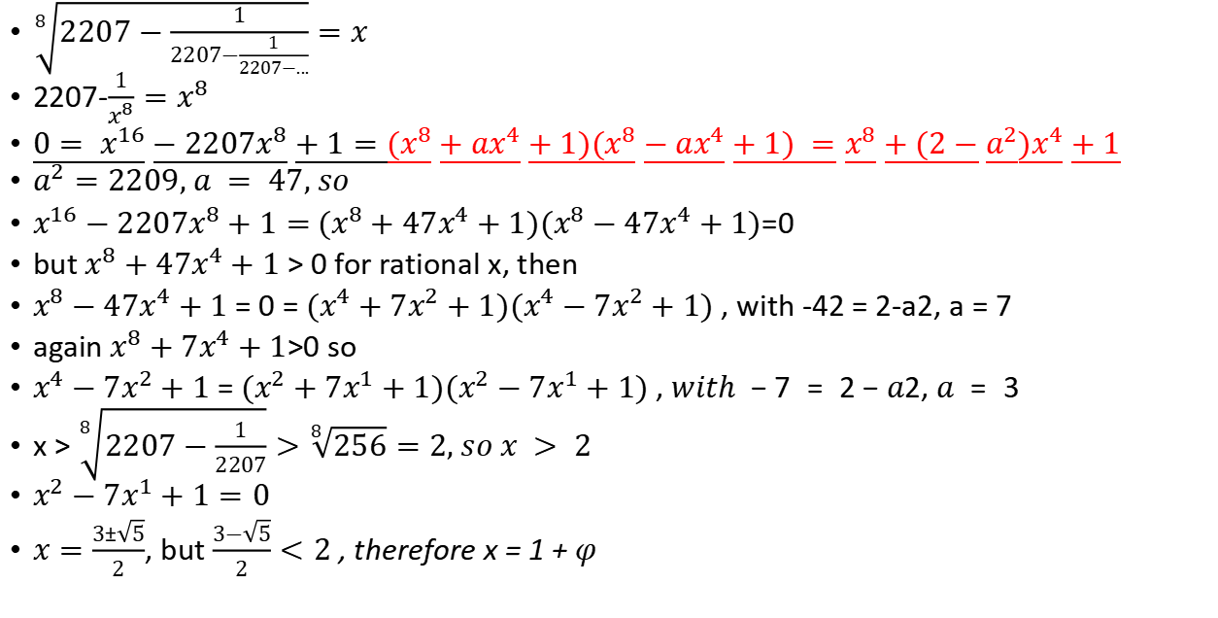
splitting $x^{2n}+ax^{n}+1$ on factors:
$\sqrt[8]{2207−\frac{1}{2207−\frac{1}{2207−...}}}=x$
2207-$\frac{1}{x^{8}}=x^{8}$
${0= x}^{16}−2207x^{8}+1=(x^{8}+ax^{4}+1)(x^{8}−ax^{4}+1) =x^{8}+(2−a^{2})x^{4}+1$
$a^{2}=2209, a = 47, so$
$x^{16}−2207x^{8}+1=$ $(x^{8}+47x^{4}+1)(x^{8}−47x^{4}+1)$=0
but $x^{8}+47x^{4}+1$ > 0 for rational x, then
$x^{8}−47x^{4}+1$ = 0 = $(x^{4}+7x^{2}+1)(x^{4}−7x^{2}+1)$, with -42 = 2-a2, a = 7
again $x^{8}+7x^{4}+1$>0 so
$x^{4}−7x^{2}+1$ = $(x^{2}+7x^{1}+1)(x^{2}−7x^{1}+1) , with −7 = 2−a2, a = 3$
x > $\sqrt[8]{2207−\frac{1}{2207}}>\sqrt[8]{256}=2, so x > 2$
$x^{2}−7x^{1}+1=0$
$x=\frac{3±\sqrt{5}}{2}$, but $\frac{3−\sqrt{5}}{2}<2$ , therefore x = 1 + $φ$

Slide 7
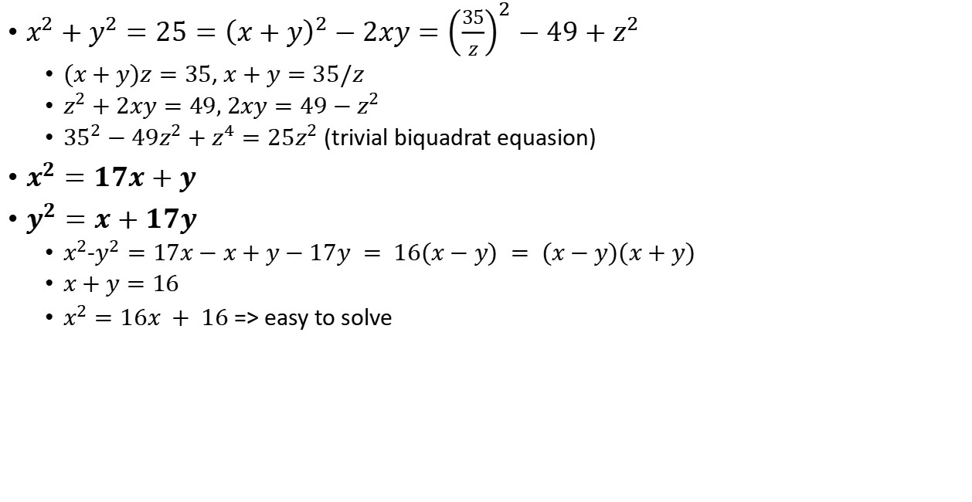
substitution in a system of equasions
$x^{2}+y^{2}=25={\left(x+y\right)}^{2}−2xy={\left(\frac{35}{z}\right)}^{2}−49+z^{2}$
$(x+y)z=35$, $x+y=35/z$
$z^{2}+2xy=49, 2xy=49−z^{2}$
${35}^{2}−49z^{2}+z^{4}=25z^{2}$ (trivial biquadrat equasion)
$x^{2}=17x+y$
$y^{2}=x+17y$
$x^{2}$-$y^{2}=17x−x+y−17y = 16(x−y) = (x−y)(x+y)$
$x+y=16$
$x^{2}=16x + 16$ => easy to solve

Slide 8
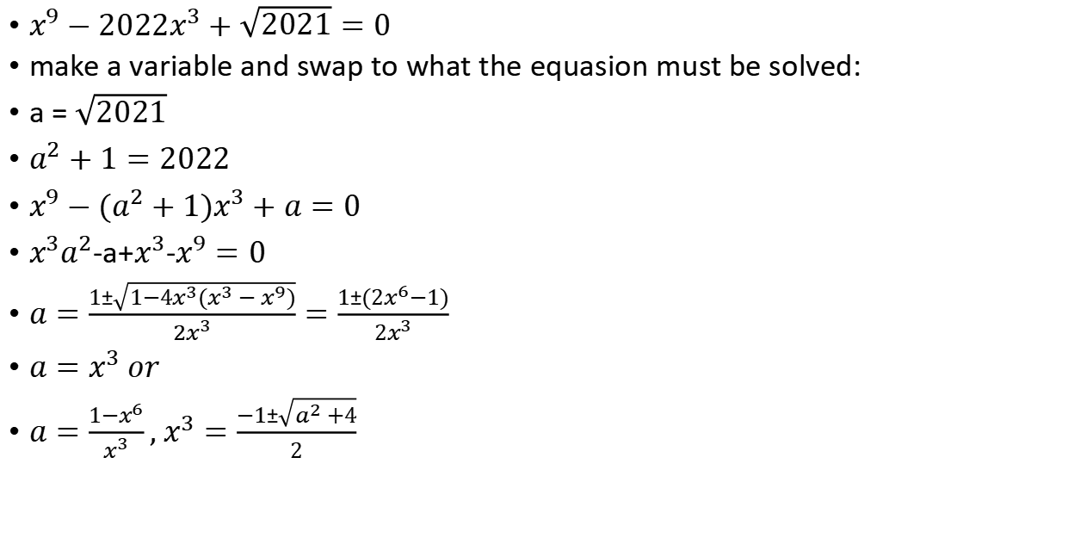
Swap parameter and variable:
$x^{9}−2022x^{3}+\sqrt{2021}=0$
make a variable and swap to what the equasion must be solved:
a = $\sqrt{2021}$
$a^{2}+1=2022$
$x^{9}−({a^{2}+1)x}^{3}+a=0$
$x^{3}a^{2}$-a+$x^{3}$-$x^{9}=0$
$a=\frac{1±\sqrt{1−4x^{3}(x^{3}−x^{9})}}{{2x}^{3}}=\frac{1±(2x^{6}−1)}{2x^{3}}$
$a=x^{3} or$
$a=\frac{1−x^{6}}{x^{3}}, x^{3}=\frac{−1±\sqrt{a^{2}+4}}{2}$

Slide 9

Assume split of polynomЮ
$x^{4}+x^{3}−2x^{2}−3x−3 = (assume)=(x^{2}+ab+b)(x^{2}+cb+d)$

Slide 10
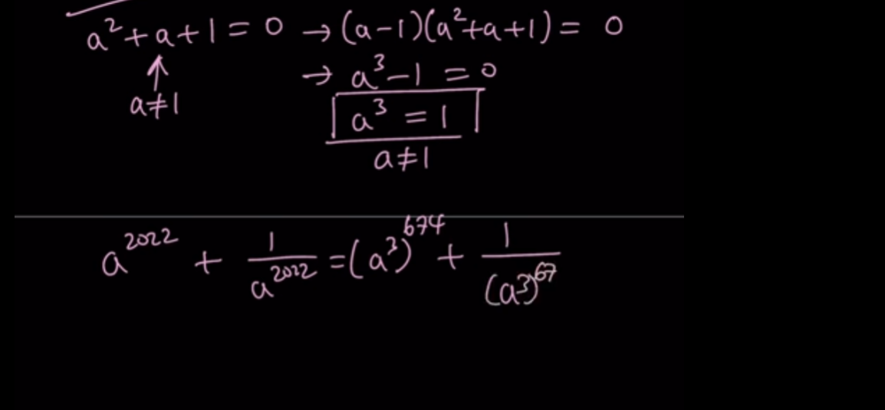

Slide 11
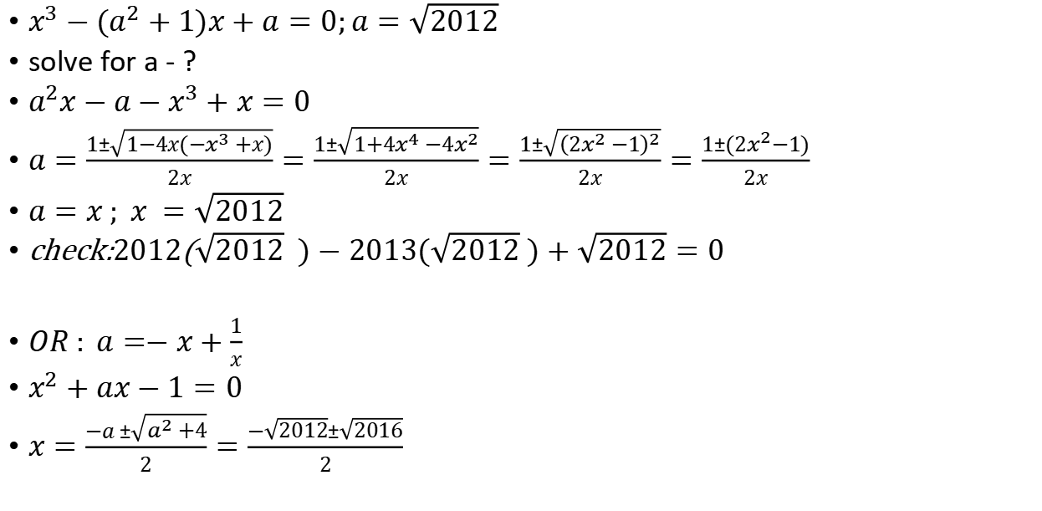
$$x^{3}−2013x+\sqrt{2012}=0$$
$x^{3}−(a^{2}+1)x+a=0;a=\sqrt{2012}$
solve for a - ?
$a^{2}x−a−x^{3}+x=0$
$a=\frac{1±\sqrt{1−4x(−x^{3}+x)}}{2x}=\frac{1±\sqrt{1+4x^{4}−4x^{2}}}{2x}=\frac{1±\sqrt{{\left(2x^{2}−1\right)}^{2}}}{2x}=\frac{1±(2x^{2}−1)}{2x}$
$a=x ; x =\sqrt{2012}$
check:$2012$($\sqrt{2012} )−2013(\sqrt{2012} )+\sqrt{2012}=0$
$OR : a=−x+\frac{1}{x}$
$x^{2}+ax−1=0$
$x=\frac{−a ±\sqrt{a^{2}+4}}{2}=\frac{−\sqrt{2012}±\sqrt{2016}}{2}$

Slide 12


$$\frac{x−1}{x}+\frac{x−2}{x}+...+\frac{1}{x}=3$$
we add x-1 times, so
3x = x-1+x-2+...+x-(x-1)=x(x-1) -(1+2+...+x-1) =x(x-1) -$\frac{x(x-1)}{2}=\frac{x(x−1)}{2}$
6 = x-1; x = 7
check:
$\frac{6}{7}+\frac{5}{7}+\frac{4}{7}+\frac{3}{7}+\frac{2}{7}+\frac{1}{7}=\frac{21}{7}=3$

